Slide 1

East Hertfordshire
District Council
Electoral Review
Parish &
Community
Briefing
www.lgbce.org.uk | consultation.lgbce.org.uk | @lgbce | reviews@lgbce.org.uk

Slide 2
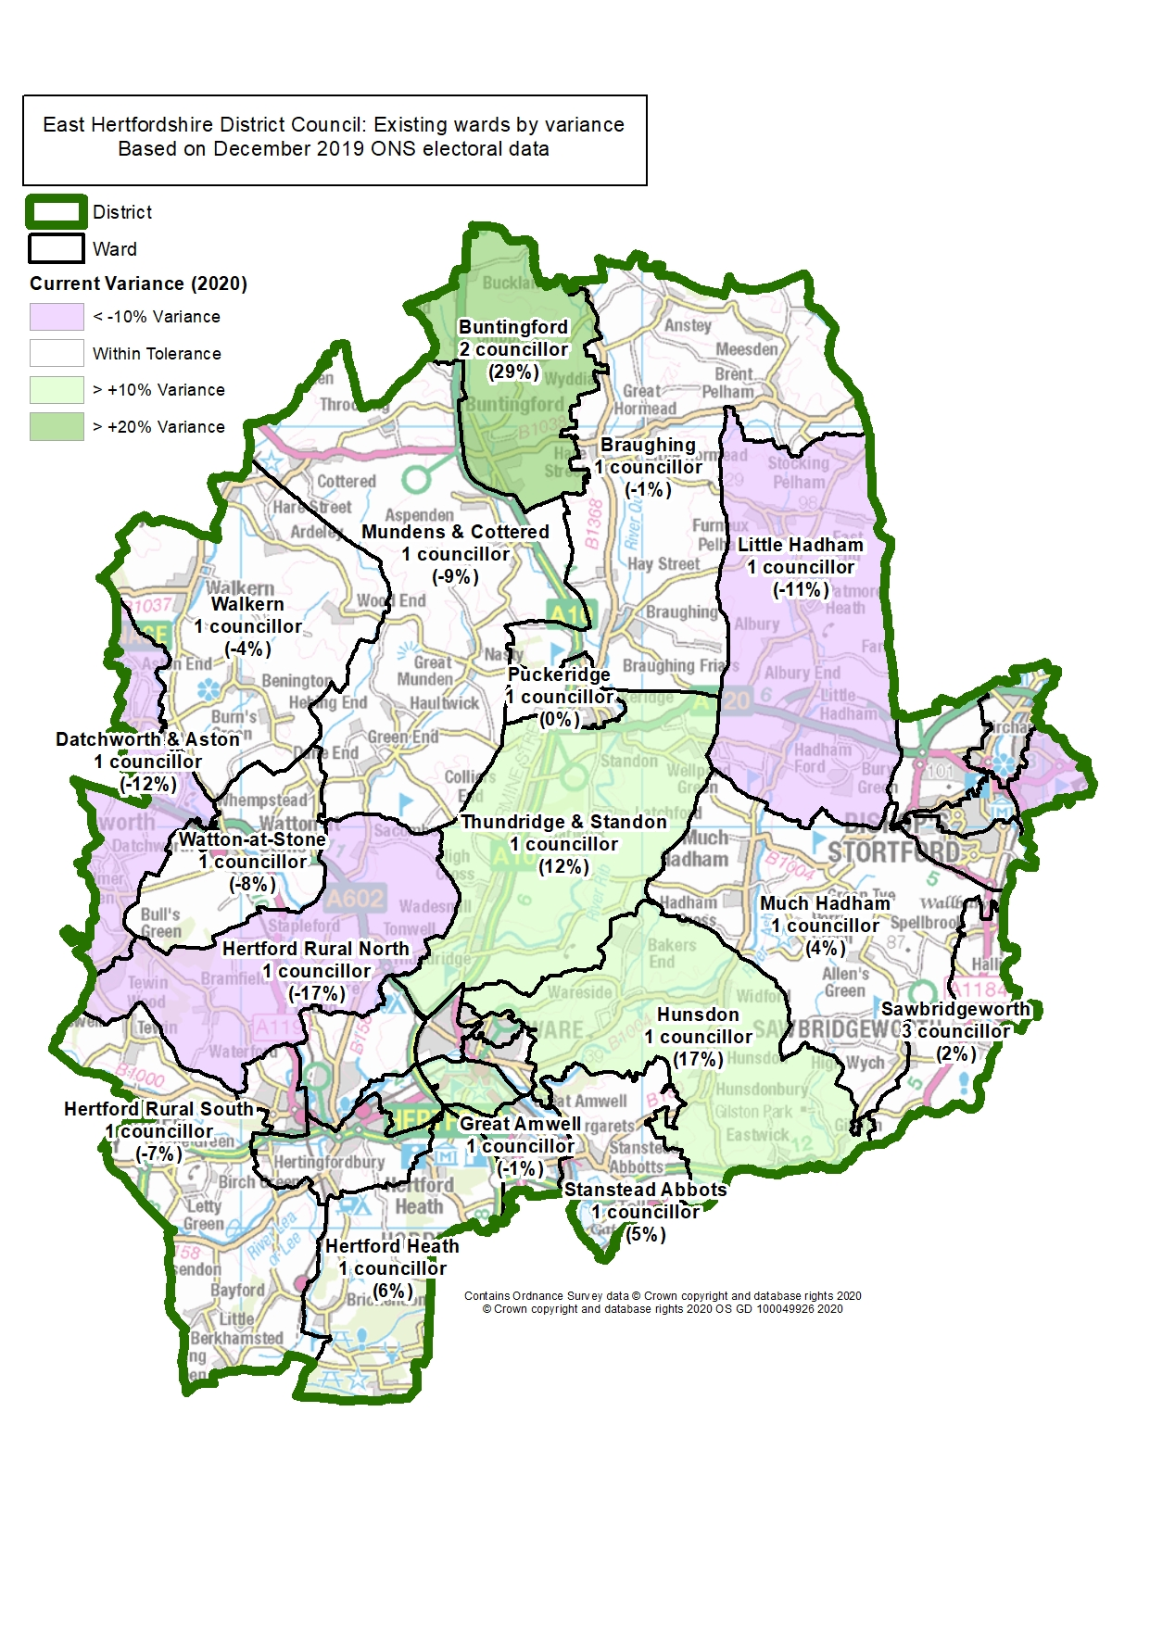
Why East Hertfordshire?
East Hertfordshire’s boundaries have been not reviewed since 1998.

Slide 3
What does an Electoral Review Determine?
Total number of councillors
Total number of wards
Ward boundaries
Number of councillors elected to each ward
Names of each ward
BALLOT BOX
www.lgbce.org.uk | consultation.lgbce.org.uk | @lgbce | reviews@lgbce.org.uk

Slide 4
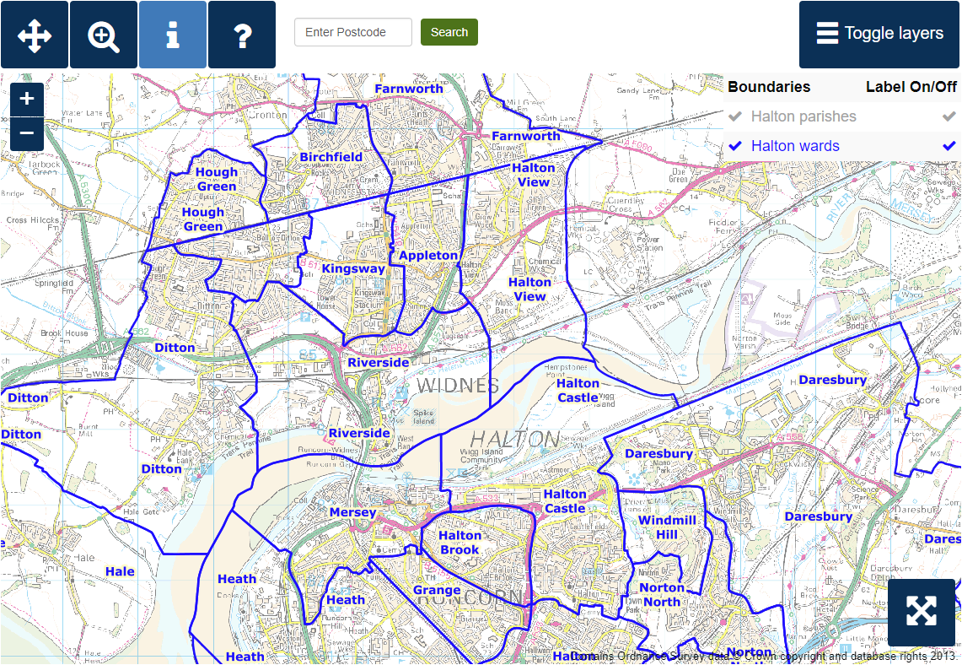
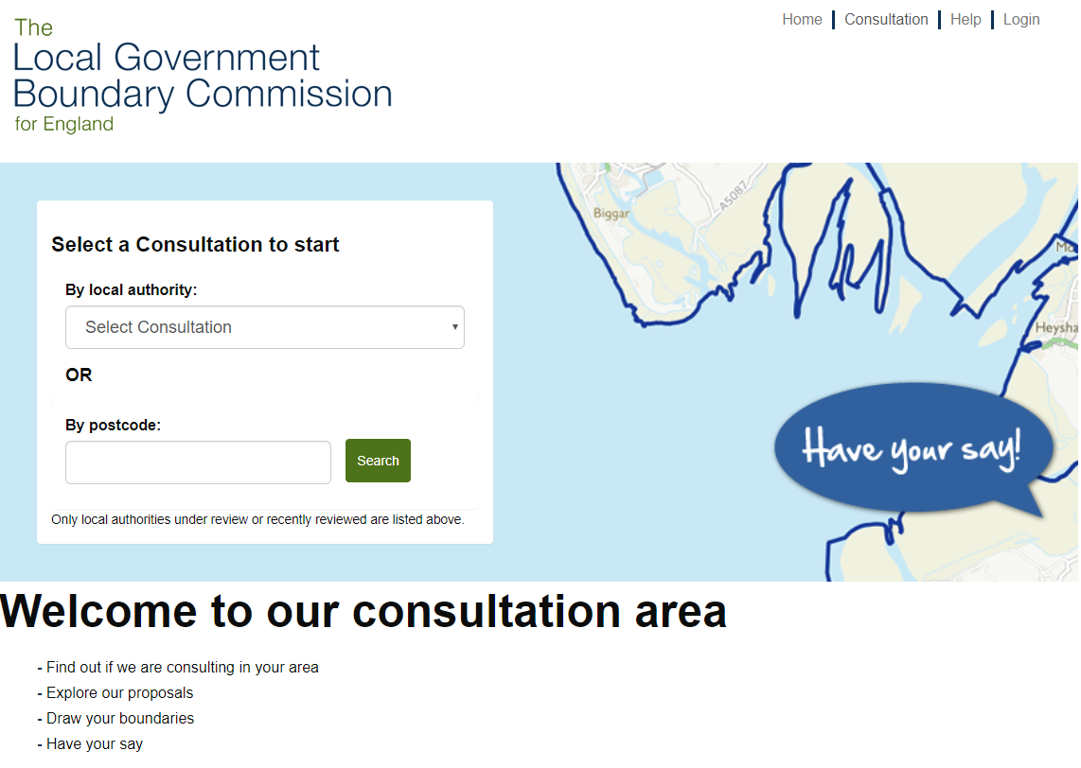
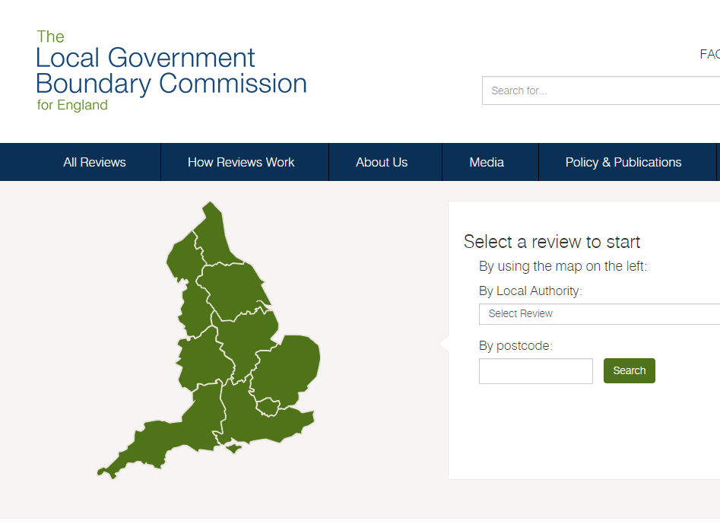
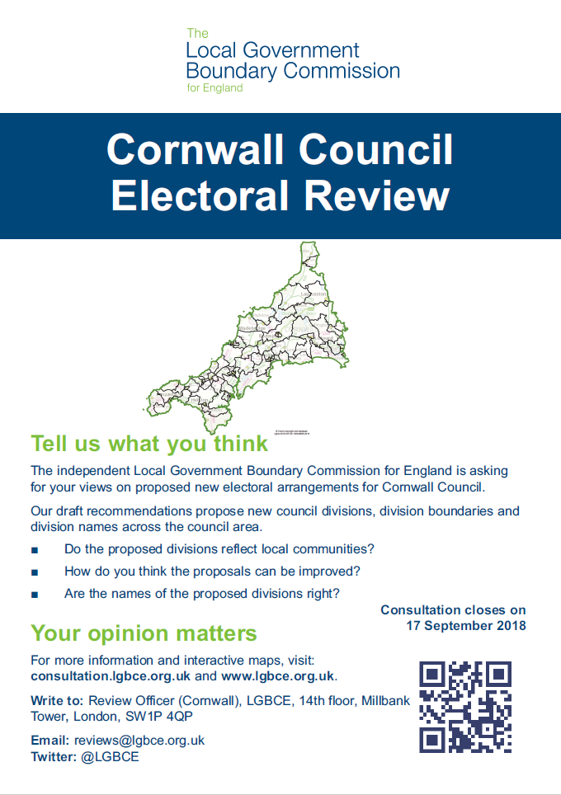
Making a difference
Get involved.
Help shape your council for the long term.
Help us make it a transparent & consultative process.
Help influence & encourage.
Local knowledge is invaluable to this process.
www.lgbce.org.uk | consultation.lgbce.org.uk | @lgbce | reviews@lgbce.org.uk

Slide 5
Warding Patterns
Effective representations will address:
When?
Consultation on warding patterns: 28 September 2021 to 6 December 2021
Consultation on draft recommendations: 1 March 2022 to 9 May 2022
Electoral equality for voters
Community identities and interests
Effective and convenient local government
www.lgbce.org.uk | consultation.lgbce.org.uk | @lgbce | reviews@lgbce.org.uk
Notes:
There will be at least two opportunities for you to influence the pattern of wards we draw up.
In the first round of consultation, which will start on 28 September 2021, we will start with a blank map. This will be your first opportunity to come up with ideas for new wards.
Based on the evidence we receive from yourselves during that first consultation, we will draw up draft recommendations. You will then be given a another opportunity to say whether you do or don’t like what we have proposed.
BUT, before you have your say, there are a few things to bear in mind.
The Commission is bound by rules that are set out in law when it draws up ward boundaries.
So if you take anything away from this presentation, it’s the three criteria set out here.
First, electoral equality – We want wards that mean each councillor represents roughly the number of voters. We look at that based on the forecast electorate. We will publish five-year electorate forecasts on our website down to polling district level. This figures are what we base our wards on.
Next is community identity – we want evidence about where people go to access amenities, facilities or shops. We want our wards to reflect local communities in East Herts.
Lastly, is effective & convenient local government – this basically means we look for boundaries that make sense on the ground, have complete internal transport links and are sensibly named.

Slide 6
Community Identity
Parishes & neighbourhood groups as building blocks
Facilities and amenities
Landmarks
Transport
BALLOT BOX
www.lgbce.org.uk | consultation.lgbce.org.uk | @lgbce | reviews@lgbce.org.uk
Notes:
Parishes often give us strong evidence on community identities in their area which makes it easier for us to build wards that mean something to people. We often use them as building blocks when creating our wards.
But what do we mean by community identity?
Does your parish or group share local issues with other neighbouring parishes that should be included in the same ward?
Are there shops, services and amenities that serve a particular community in your area that could form the basis of a ward?
What are the landmarks, natural and constructed, that might make for easily identified boundaries?
Tell us about transport links. A good ward is usually easy to travel around not just by car but by public transport too.
Essentially, we are trying to build wards that local people can identify with. Give us evidence about the way communities in your interact.

Slide 7
Parishes
We cannot create or abolish parishes, or amend their external boundaries
If we divide a parish between wards, we must create parish wards
We can change parish electoral arrangements only as a direct consequence of our ward proposals
Notes:
Of course, there are some specific rules that relate to parish councils.
We can't change the external boundaries of your parish or town council.
However, if we draw a ward boundary through your parish, we have to create parish wards that reflect that boundary.
BUT, if your parish is unaffected by our proposals, we won’t propose any changes to your parish arrangements.
We will write to your parish council at every stage of the review to let you know what we are proposing, including details of changes to your arrangements if relevant.

Slide 8
Early 2021
Preliminary period
Commission decides councillor numbers
Now to August 2021
Mid 2021
Review Timeline
Consultation on
warding patterns
28 September 2021 to 6 December 2021
Winter 2021
Consultation on draft recommendations
1 March 2022 to 9 May 2022
Mid 2022
Final recommendations
Published 2 August 2022
Order Made Winter 2022
Elected upon 2023
Late 2022
2023
www.lgbce.org.uk | consultation.lgbce.org.uk | @lgbce | reviews@lgbce.org.uk
Notes:
Here is how the various parts of the process fit together on a timeline.
The timetable sometimes changes. For example, if we decide to carry out extra phases of consultation. So keep an eye out on the dedicated web page for the review.

Slide 9
Getting in touch
Make a submission: consultation.lgbce.org.uk
Website: www.lgbce.org.uk
Email: reviews@lgbce.org.uk
Write: Review Officer (East Hertfordshire)
LGBCE
PO Box 133
Blyth
NE24 9FE
Social media: @LGBCE
www.lgbce.org.uk | consultation.lgbce.org.uk | @lgbce | reviews@lgbce.org.uk
Notes:
There are plenty of ways to get in touch or follow the progress of the review.
We urge you to keep an eye on the website and our social media so that you can influence the outcome of the review.

